Slide 1
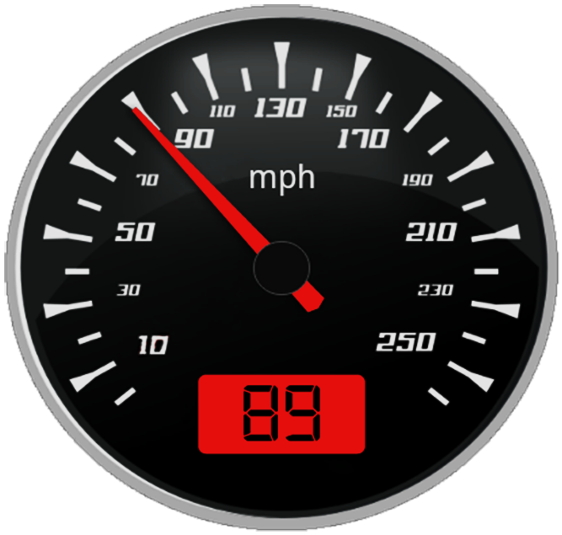
SPEED STUDIES

Slide 2
PLAN
Different measurement methods
Data presentation of Spot speed study
Different types of vehicle speed
Case study
Introduction
Conclusion

Slide 3
01
INTRODUCTION

Slide 4


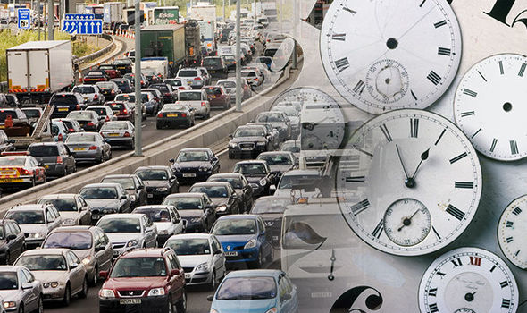

INTRODUCTION
Speed
Safety
Time
Comfort
Economics

Slide 5
INTRODUCTION : Goals of speed studies
Speed studies are used to determine the speed distribution of a traffic stream at a specific location. The data gathered in speed studies are used to determine vehicle speed percentiles, which are useful in making many speed-related decisions.
Determining existing traffic operations and evaluation of traffic control devices
Establishing roadway design elements
Assessing roadway safety questions
Monitoring traffic speed trends by systematic ongoing speed studies
Measuring effectiveness of traffic control devices or traffic programs
Speed Studies Data

Slide 6
02
Different types of vehicle speed

Slide 7
Types of speeds
Types of speeds
Spot speed
Travel speed
Running speed
Free flow speed
Time mean speed
(TMS)
Space mean speed
(SMS)

Slide 8


Definition of speed
In simple words, speed is defined as the distance travelled in a unit time. Speed is expressed in m/s, fps, or mph.
Speed is given by:
will give the average speed.
is used to find the instantaneous speed

Slide 9
Spot speed
Spot speed is the instantaneous speed of a vehicle as it passes a specified point along a road. Spot speeds may be determined by manually measuring (with use of electronic or electromechanical devices like pneumatic tube detectors or radars) the time required for a vehicle to traverse a relatively short specified distance.

Slide 10


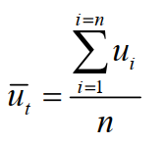

Space – Mean - Speed (SMS)
Time – Mean - Speed (TMS)
Where,
t i = observed time for the i th vehicle to travel distance d
N or n = number of vehicles observed
d = length of roadway section
where,
Ui or ui = observed speed of i-th vehicle
N or n = number of vehicles observed

Slide 11
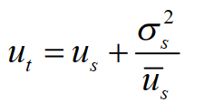
Space-mean speed and time-mean speed are not equal. For general usage, no distinction is normally made between both speeds, for theoretical and research purposes WARDROP has shown in his calculations that :
Avec : Ơs2 = variance de la distribution spatiale des vitesses

Slide 12
Free flow speed
The desired speed of drivers in low volume conditions and in the absence of traffic control devices. In other words, the mean speed of passenger cars that can be maintained in low to moderate flow rates on a uniform freeway segment prevailing roadway and traffic conditions.
Factors affecting free flow speed:
Width
Lateral clearance
Number of lanes
Side friction
Interchange density
Geometric design
Weather (The amount of reduction in free-flow speed is directly related to the severity of the weather event).
Visibility.

Slide 13
Travel speed
Travel speed is the effective speed of the vehicle on a journey between two points and is the distance between the two points divided by the total time taken for the vehicle to complete the travel including any stopped time. If the journey speed is less than running speed, it indicates that the journey follows a stop-go condition with enforced acceleration and deceleration. The spot speed here may vary from zero to some maximum in excess of the running speed. Uniformity between travel and running speeds denotes comfortable travel conditions.

Slide 14
Running speed
Running speed is the average speed maintained over a particular course while the vehicle is moving and is found by dividing the length of the course by the time duration the vehicle was in motion. i.e. this speed doesn't consider the time during which the vehicle is brought to a stop, or has to wait till it has a clear road ahead. The running speed will always be more than or equal to the travel speed, as delays are not considered in calculating the running speed.

Slide 15
03
Different measurement methods

Slide 16
Methods for spot speed data collection
Stopwatch method
Radar meter method
The Jumelles Laser
Pneumatic method
Aerial photography

Slide 17
1 - Stopwatch method
The stopwatch method can be used to successfully complete a spot speed study using a small sample size taken over a relatively short period of time. The stopwatch method is a quick and inexpensive method for collecting speed data.

Slide 18
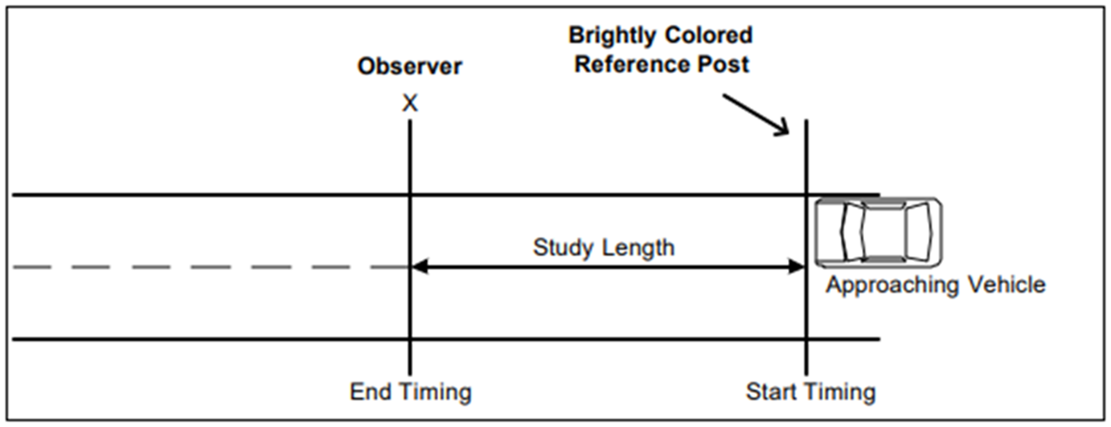
1 - Stopwatch method : Measurement methodology
As the front wheels of a vehicle (or only the lead vehicle in a group) cross a mark or pavement crack at the beginning of the predetermined study length, the observer starts the stopwatch.
The watch is stopped when the vehicle’s front wheels pass a reference line in front of the observer. A slash is recorded on the data form corresponding to the elapsed time observed.

Slide 19
2 - Radar meter method
This is a newly developed method, it records speed automatically and uses a radar transceiver.
The device transmits high frequency electromagnetic waves in a narrow beam to the moving vehicle, and the reflected waves changed their length according to the speed of the vehicle and are returned to the receiving unit,
The radar speedometer works on the principle of the Doppler effect. Radio frequency microwaves are transmitted to a moving vehicle. According to the Doppler effect, the speed of the vehicle is proportional to the change in frequency of the microwaves received by the transmitter after being reflected by the vehicle.
The speedometer is portable and battery operated; it is installed near the edge of the road about 1m height above the road surface. This is used by the traffic police department to enforce speed limits.

Slide 20
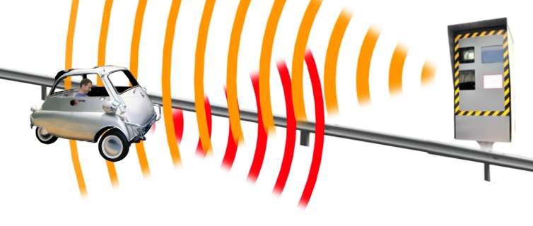
fE
fR

Slide 21
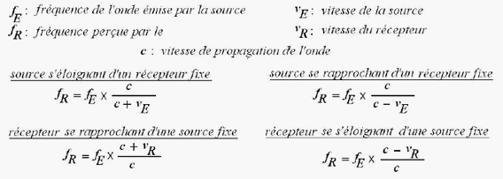
The Doppler effect
The Doppler effect is the phenomenon that characterizes the change in frequency of the wave picked up by a receiver when the transmitter and receiver are in relative motion.

Slide 22
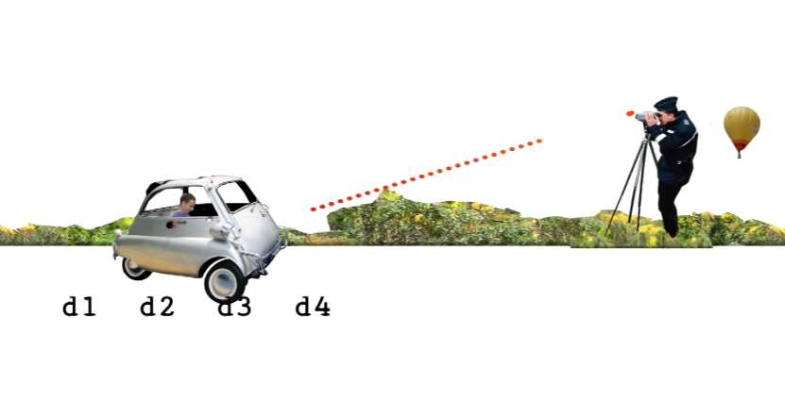
3 - The Jumelles Laser

Slide 23
4 - PNEUMATIC ROAD TUBE METHOD
The pneumatic road tube method is normally used for longer data collection periods than the stopwatch or radar method.
It is based on the generation of an overpressure which results in an electronic pulse at the level of the detector automatic data loggers are capable of storing large amounts of individual vehicle data or even larger amounts of vehicle classification data.
The data collected is downloaded from the logger to a laptop or portable floppy disk drive in the field, or via telephone modem to a central computer.

Slide 24
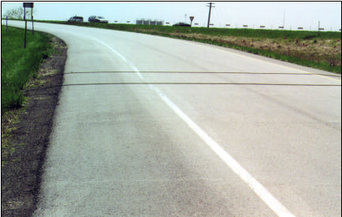

Slide 25
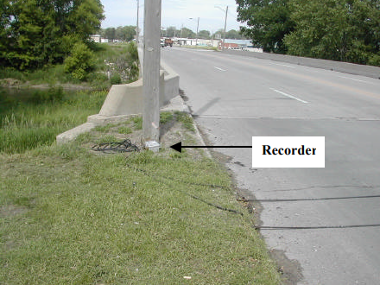

Slide 26
5 - Aerial photography
In this method:
Camera records the distance traveled by a vehicle in a selected short period of time. In this exposure the photograph must be in a constant time interval and the distance traveled by the vehicle is measured by projecting the films during the exposure interval;
The main advantage of the method is that it gives a permanent record with 100% sample obtained;
This method is quite expensive and usually used in developed cities;
We can use a video recorder which gives a more accurate result.

Slide 27
04
Data presentation of Spot speed study
Example of Spot speed data analysis

Slide 28
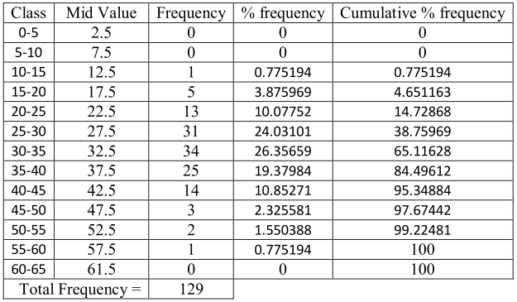
1. Frequency Distribution table
Table : Statistical calculation table of spot speed data

Slide 29
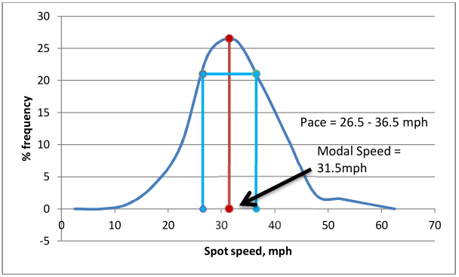
2. Frequency Distribution Diagram
Figure : % Frequency vs Spot speed curve

Slide 30
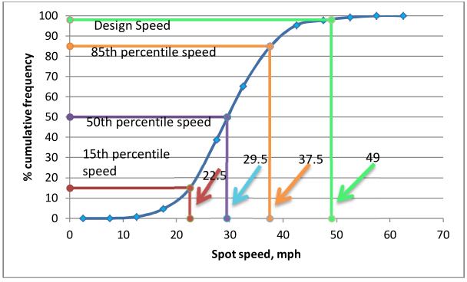
3. Cumulative speed distribution diagram
Figure : % Cumulative frequency vs Spot speed curve

Slide 31
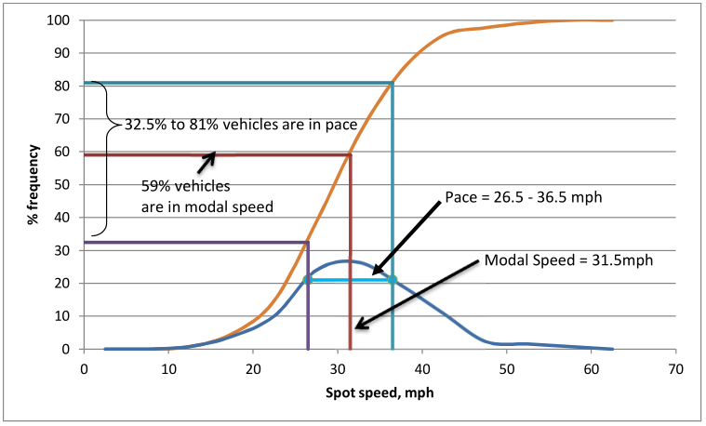
4. Combination of Frequency Distribution Diagram & Cumulative speed distribution diagram
If we combine the above two graphs then we will get the percentage of vehicles below which the vehicles are in modal speed we will get the range percentage of vehicles that are in pace. In the following figure a combination is presented.
Figure : Combination of % Frequency vs Spot speed curve and Cumulative frequency vs Spot speed curve

Slide 32
05
Etude de cas

Slide 33
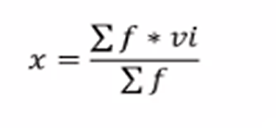
Etude de cas : Exercice (Calculation)
The calculated mean (or average) speed is used to represent the true mean value of all vehicle speeds at that location. The accuracy of this assumption depends on the number of vehicles in the sample. The larger the sample size, the greater the probability that the estimated mean is not significantly different from the true mean. It is therefore necessary to select a sample size that will give an estimated mean within acceptable error limits. Statistical procedures are used to determine this minimum sample size. Before discussing these procedures, it is first necessary to define certain significant values that are needed to describe speed characteristics, They are:
1. Average Speed which is the arithmetic mean of all observed vehicle speeds (which is the sum of all spot speeds divided by the number of recorded speeds). it is given as :
Where
u = arithmetic mean
li = number of observations in each speed group
Uj = mid value for the ith speed group
N = number of observed values.

Slide 34
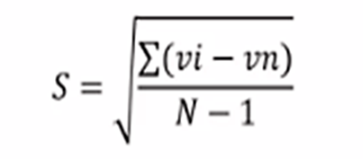
Median Speed which is the speed at the middle value in a series of spot speeds that are arranged in ascending order. 50 percent of the speed values will be greater than the median; 50 percent will be less than the median.
Modal Speed which is the speed value that occurs most frequently in a sample of spot speeds.
The ith-percentile Spot Speed which is the spot speed value below which i percent of the vehicles travel; for example, 85th-percentile spot speed is the speed below which 85 percent of the vehicles travel and above which 15 percent of the vehicles travel.
Pace Speed: the highest speed within a specific range of speeds that represents more vehicles than in any other like range of speed. The range of speeds typically used is 10 km/h or 10 mph. Pace
Standard Deviation of Speeds which is a measure of the spread of the individual speeds. it is estimated as The 10 Km\h speed range representing the speeds of the largest percentage of vehicles in the traffic stream.
where
S = standard deviation
u = arithmetic mean
Uj = jth observation
N = number of observation

Slide 35
Questions
1. Calculate the average speed.
2. Calculate the standard deviation.
3. Calculate the median speed.
4. What is the pace speed?
5. What is the modal speed?
6. What is the speed above which only 15% of vehicles travel? (the percentile speed 85).
7. What is the standard error of the mean?

Slide 36
Speed Group | Mean speed of group (v) | Number of vehicle in group (f) | Percent of total observations in group | Cumulative percent of total observations | V*f | (v-x)^2 | f*(v-x)^2
20-24,9 | 22,45 | 0 | 0 | 0 | 0 | 760,877 | 0
25-29,9 | 27,45 | 5 | 1,5 | 1,5 | 137,25 | 510,037 | 2550,18528
30-34,9 | 32,45 | 13 | 4 | 5,5 | 421,85 | 309,197 | 4019,56173
35-39,9 | 37,45 | 27 | 8,2 | 13,7 | 1011,15 | 158,357 | 4275,64051
40-44,9 | 42,45 | 50 | 15,2 | 28,9 | 2122,5 | 57,517 | 2875,8528
45-49,9 | 47,45 | 66 | 20,1 | 48,9 | 3131,7 | 6,677 | 440,685696
50-54,9 | 52,45 | 72 | 21,9 | 70,8 | 3776,4 | 5,837 | 420,268032
55-59,9 | 57,45 | 52 | 15,8 | 86,6 | 2987,4 | 54,997 | 2859,84691
60-64,9 | 62,45 | 24 | 7,3 | 93,9 | 1498,8 | 154,157 | 3699,76934
65-69,9 | 67,45 | 15 | 4,6 | 98,5 | 1011,75 | 303,317 | 4549,75584
70-74,9 | 72,45 | 5 | 1,5 | 100 | 362,25 | 502,477 | 2512,38528
75-79,9 | 77,45 | 0 | 0 | 100 | 0 | 751,637 | 0
 | Σ | 329 | 100 |  | 16461,05 | 3575,084 | 28203,95

Slide 37
Kahoot

Slide 38
06
Conclusion

Slide 39
THANK YOU

